Slide 1

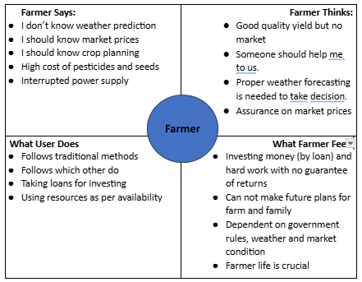
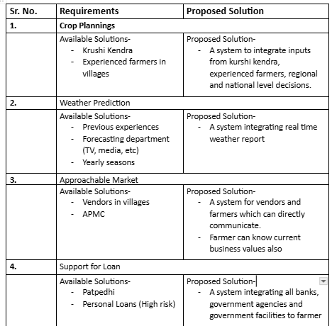
Proposed Architecture/ Diagram:
IEEE Summer Research Internship
Class : TYCORE1
Group Id: 09
DEPARTMENT OF COMPUTER SCIENCE & ENGINEERING
MOOD RECOGNITION
AI based methodology to predict emotion using facial expressions
Sanika purbuj, Mrunal Tukan, Darshika Rathod, Palak Kulshrestha
Faculty Guide:
Dr. Anupama Budhewar
Block Diagram
Problem statement
A farmer is a backbone of nation for raising food or raw need of human being, who needs technical support to overcome traditional planning for crop, unpredictable weather and market conditions and awareness of government policies because they are not having guaranteed returns due to which they are failing to plan good life.
Scope and Feasibility
4 Modulesl
Market analysis and approach
Loan and government schemes integration
Resource plannings
Integration of all modules
Proposed Solution
Multiciliated system will help farmers to register and help them to plan crops, share resources, avail loans, vendor and market facility along with weather prediction.

